Slide 1

Lebanon: A Land of Refuge
Ariel Royer
Global Mission Intern, 2013-2015
Global Ministries of the
United Church of Christ & Disciples of Christ
Notes:
7:08-7:11 My background
I spent the final chapter of my service with Global Ministries in Beirut, Lebanon in 2015. The focus on services for refugees brought my service full circle, as I had begun as a Global Mission Intern in 2013 working with the Orthodox Initiative to address the refugee crisis in Jordan. I was able to gain the perspective that these two countries both were hosting refugees but in different proportions and with different results.

Slide 2



Syria
Lebanon
Jordan
Israel
occupied Palestinian territories
Notes:
7:08-7:11 My background
I spent the final chapter of my service with Global Ministries in Beirut, Lebanon in 2015. The focus on services for refugees brought my service full circle, as I had begun as a Global Mission Intern in 2013 working with the Orthodox Initiative to address the refugee crisis in Jordan. I was able to gain the perspective that these two countries both were hosting refugees but in different proportions and with different results.

Slide 3
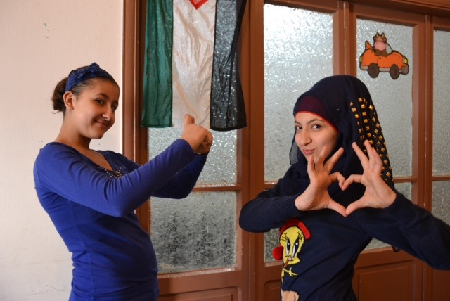
Notes:
7:11-7:15 A story about Palestinian/Syrian refugee: My Armenian-Syrian friends whom I met in Beirut shared with me reflections on what the war had done to their church community in Aleppo, Syria. Story about the photographs of Sunday School children.

Slide 4
Lebanon
Population | 4.3 million
Size | 4,036 sq miles – about the size of Connecticut
Religious make-up | 40% Christian, 27% Sunni, 27% Shia, 5.6% Druze
Type of Government | Confessional
President | None, since 2014
Prime Minister | Tammam Salam
Modern History
1516 -1918
1918 -1944
1975 -1990
1982
2000
2005
2006
Part of Ottoman Empire
Part of French Mandate
Lebanese Civil
War
Massacre at Sabra & Shatila Refugee Camps
Israel withdraws from southern Lebanon
Ex-PM Rafik Hariri assass-inated
War between Hezbollah and Israel
Sources: BBC; CIA World Factbook
Notes:
7:15-7:20 Background on Lebanon – talk briefly about the internal problems that Lebanon faces: a disjointed country, what seemed like a quick recovery from the civil war but which has actually festered in the post-civil war period, lack of governmental productivity, instability (somewhat from Syrian civil war spillover), fear of less stability (car bombs), and lack of willingness to work together (see: garbage crisis, lack of president)

Slide 5
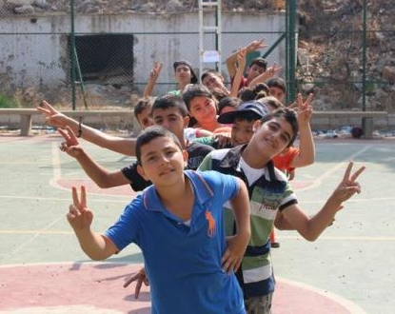
Refugees in Lebanon
4,300,000 Lebanese Citizens
1,069,111 Syrian Refugees
450,000 Palestinian Refugees
Notes:
¼ people in Lebanon is a refugee. If this phenomenon occurred in the US, it would be the equivalent of almost 80 million people extra people in a period of 5 years.
Switch: show photo of refugees in Lebanon

Slide 6
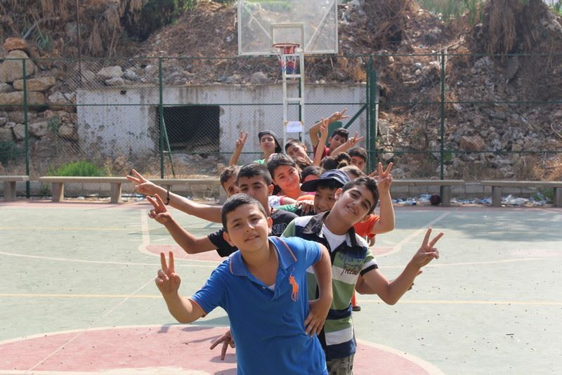
Notes:
Transition to talking about Palestinian Refugees

Slide 7
Palestinian Refugees in Lebanon
450,000 registered by UNRWA
Source: UNRWA
Notes:
7:23-7:27 Palestinian – since 1948 or 1967
What is their role in society? What restrictions are placed on them?
The vast majority of the PRL labour force works informally, with less than 14% having an
employment contract. From UNRWA:
PRL
• All professions, except the senior ‘white collar’ occupations, report poverty rates of higher
than 50 percent.
• Palestine refugees are still prohibited from practicing in several professions.
PRS
• PRS Unemployment rate is 52.5%, more than double the rate for PRL (23.2%).
• 97.7% only have verbal agreements with their employers.
• Four out of five female headed families do not have any working member (2014 PRS Vulnerability Assessment).
Still very passionate about Palestine – perhaps there is more zeal because it is inaccessible
Statistics:
Palestinian Refugees in Lebanon living in Camps: 52%: 260,000-280,000
Palestinian Refugees from Syria: 40,087
Total Palestinian Refugees registered in Lebanon: 450,000

Slide 8
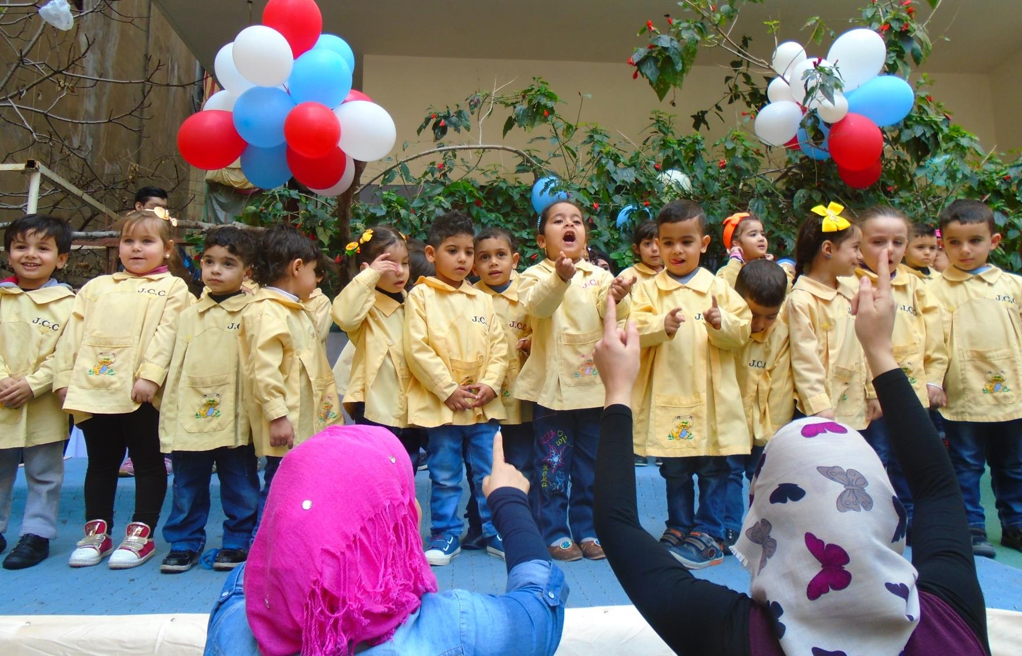
Notes:
7:27-7:28 Story: Palestinian students in class, knowing which village their grandparents’ came from and calling that home. The concept of home in Arabic has extremely deep roots: different from our American perspective, where we might call home the place where our parents grew up, but perhaps even are ready to re-associate ourselves with a new place after living there for a few years.

Slide 9
Syrian Refugees
1,069,111 registered with UNHCR
Notes:
7:28-7:31 Syrian – of all walks of life; it is not too difficult to recognize who is Syrian vs. who is Lebanese because of the different Arabic accents. However, there is discrimination against the lower-class Syrian refugees.
1,069,111 registered with UNHCR
In Lebanon
73% of Syrian registered adults are not working (50% among men and 93% among women). On average, one member of the family, regardless of the household size, is responsible for supporting the entire family financially.
14: Average number of days worked per month among those working
$12.77: Average income per day among those working
$177: Average monthly income among those working
1 person generates income and supports the family regardless of the size – up to 12 family members supported by 1 breadwinner

Slide 10
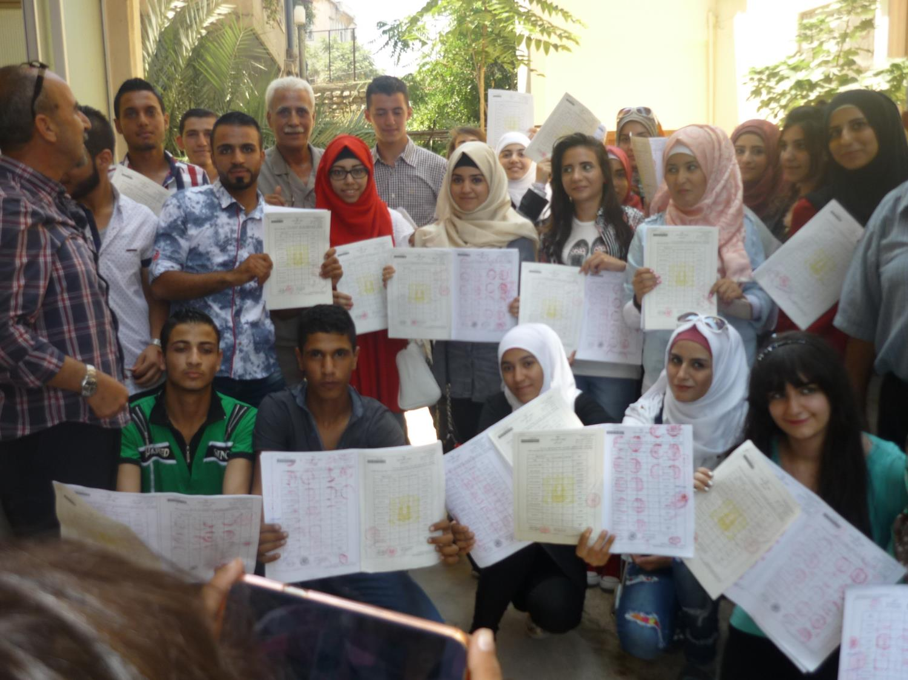

Slide 11
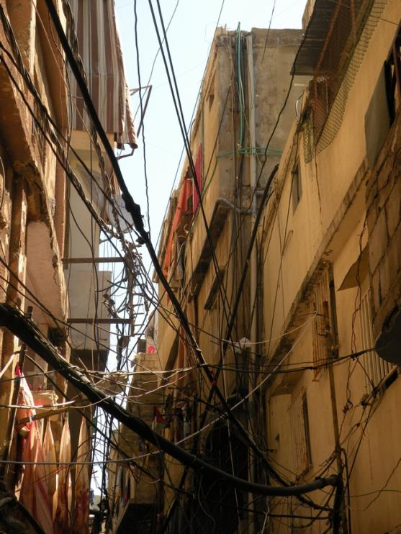
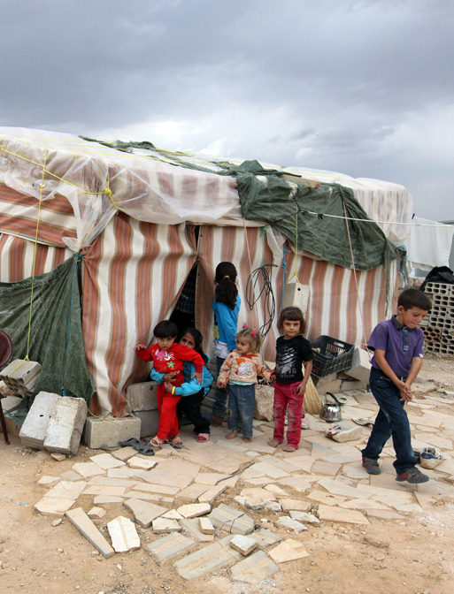
Palestinian Refugee Camp
Syrian Refugee Camp
Zeina Azzam
Associated Press
Notes:
7:31-7:33 What is the same about these two refugee populations?
Neither one is very stable – Lebanon is reluctant to give either any sort of stability.
What is different?
Palestinians have been there for much longer, and therefore have set up communities on the fringe of the law – illegal buildings constructed out of necessity but without stable infrastructure in electricity and water supply. Photo from Shatila by Zeina Azzam: being inside the twisting alleyways of the camp, the buildings are built right up next to each other, allowing for little light. To make matters gloomier, there are webs of cables and tubes created so that houses can access electricity and water.

Slide 12

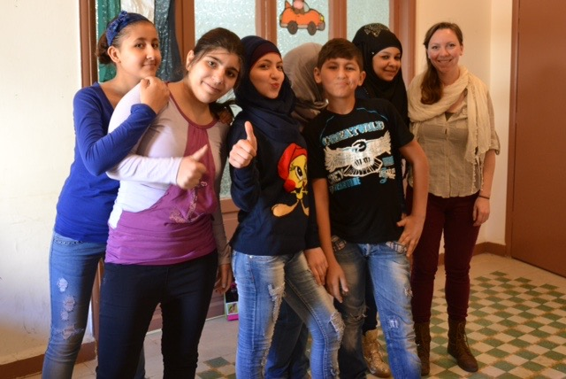
Primary & Secondary Education & Vocational training for Palestinian & Syrian refugees
Ecumenical Christian Council in the Middle East working in inter-religious dialogue, social services, and ecumenical issues
Notes:
7:33-7:39 What our partners are doing: List partners in Lebanon. Lift up the ones I have worked with & give examples of their work
MECC: food parcels, distributions, workshops
JCC: education, vocational training, low-cost daycare for the refugee camps,

Slide 13
Notes:
7:39-7:41 Story: of the woman who I helped cross the alley
7:41-8:00 Take questions

Slide 14
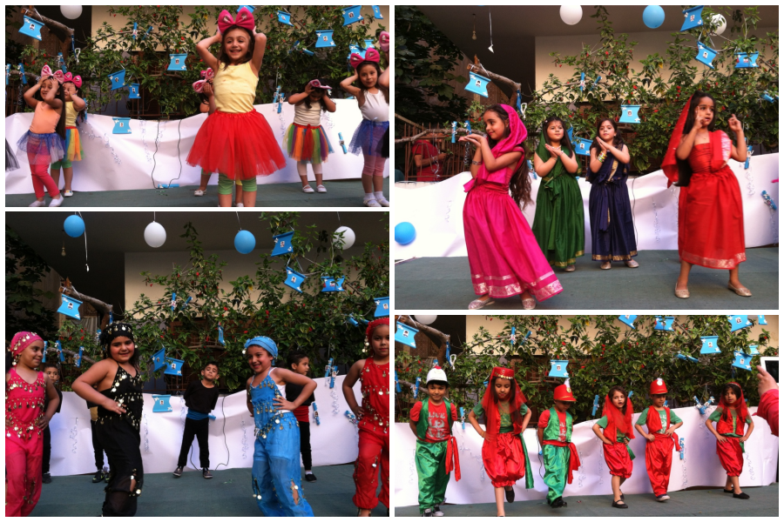
Notes:
7:41-8:00 Take questions

